Slide 1
Web-editor for reproducible pipelines
Resources and microservices

Slide 2
MLDev experiments web application
A web application and a visual studio code extension for editing pipelines with auto-saving and automatic syntax and cohesion checking, embedded into the “MLOps Platform”.
MLDev experiments configurations CRUD.
Online editor with syntax highlighting, formatting.
Real Time collaboration with built-in git support system.
Experiments visualizer.
Team: Daniil Fedorov, Sergeev Ilya, Shtanov Andrey
Project repo: https://github.com/dr0p-table-users/asd
This report: https://docs.google.com/presentation/d/1YI0Aqd7tH-XX7w6ToqdwoQoFCJ33SikCYuXgVU5DMNg/edit#slide=id.gcb7127c7c7_0_0

Slide 3
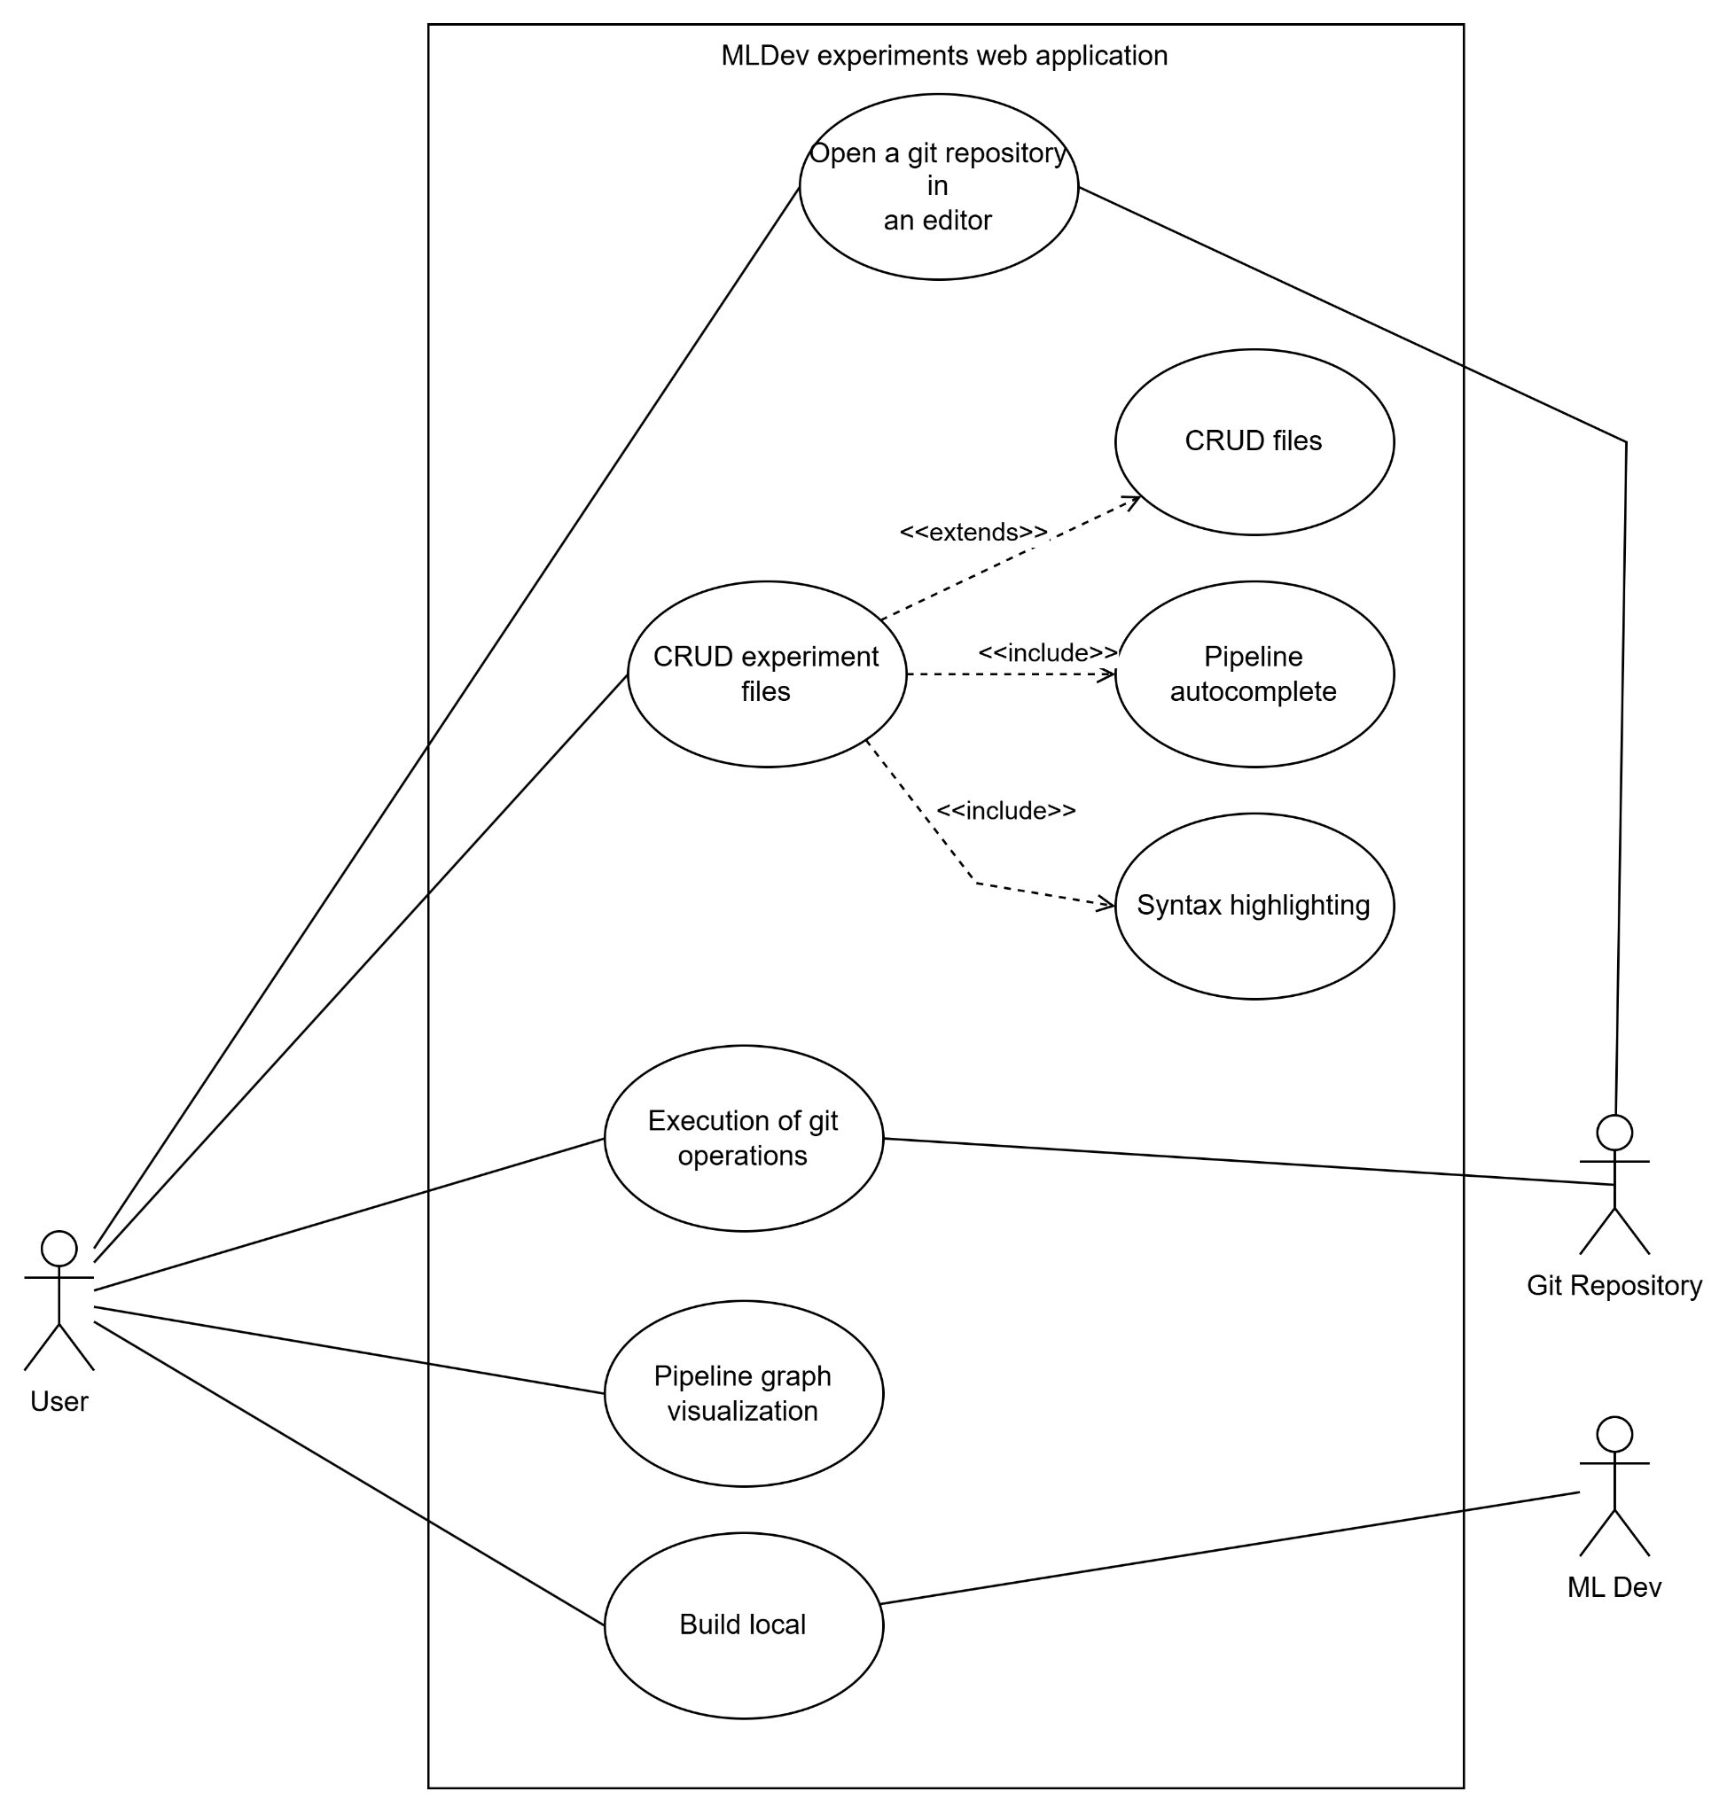
Use case diagram

Slide 4
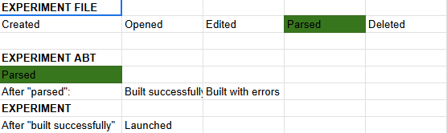
Event storming

Slide 5
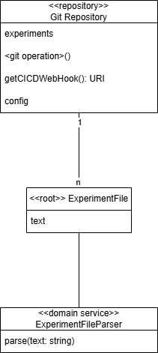
Detailed class diagram - Aggregate ExperimentFile

Slide 6
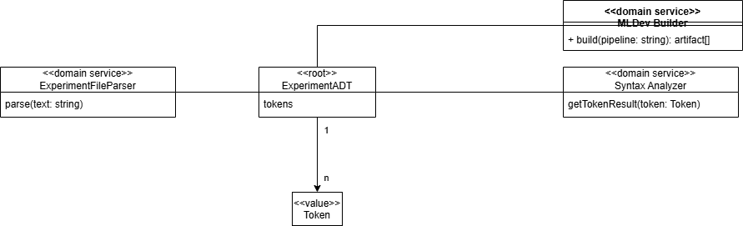
Detailed class diagram - Aggregate ExperimentADT

Slide 7
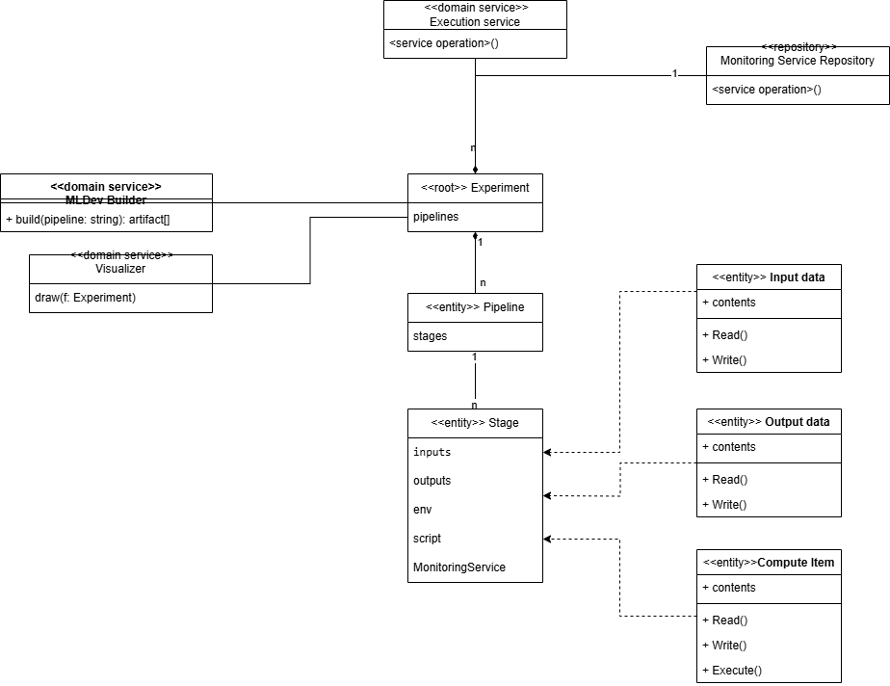
Detailed class diagram - Aggregate Experiment

